Slide 1

Code Refactoring and Bug Fixing

Slide 2
About Me
Coming from a B.Sc. Agriculture background, I've recently completed a rigorous data science course at AlmaBetter. This program equipped me with essential skills in Python, machine learning, and data analysis, fostering my transition into the dynamic field of data science. Now, I'm eager to apply my diverse background and newfound expertise to drive insights and innovation in data-driven environments.
Currently, I am interning at Innomatics Research Labs, where I am gaining practical experience in data science methodologies and techniques. This hands-on opportunity allows me to further enhance my skills and apply theoretical knowledge to real-world projects in a professional setting.

Slide 3
Scenario:
A team of enthusiastic data scientists embarked on a mission to develop a Note Taking Application using Python, Flask, and HTML. However, their lack of experience in backend development has led to challenges in making the application fully functional. Recognizing your proficiency in backend development, you have been tasked with fixing the broken code and ensuring the application works seamlessly.
Task:
Refactor the existing codebase and ensure the proper functioning of the Note Taking Application. Document all identified bugs during the debugging process. Remember, the task is not about recreating the app from scratch. Your goal is to fix the already existing codebase and make the application work as intended.
More Details:
The application's home route contains a text field and a button. Users can add a note, and all the notes should be displayed as an unordered list below the text field on the same page.

Slide 4
Bug Fix 01
Identification:
The HTML form on the home page lacked a specified action attribute, leading to a default empty action. Additionally, the form button in the HTML template lacked a specified type attribute.
Solution:
1. Updated the form tag in the HTML template to include action="/" method="post".
2. Added type="submit" attribute to the form button in the HTML template.
Outcome:
These modifications ensured proper form submission behavior. Users can now successfully submit notes through the form on the home page without encountering any difficulties.

Slide 5
Bug Fix 02
Identification:
The Flask route failed to verify whether the submitted note was empty before adding it to the notes list.
Solution:
Implemented a validation check within the Flask route by adding if note: before appending the note to the list. This ensures that only non-empty notes are included in the list.
Outcome:
Empty notes are now effectively filtered out, preserving the integrity of the notes list.

Slide 6
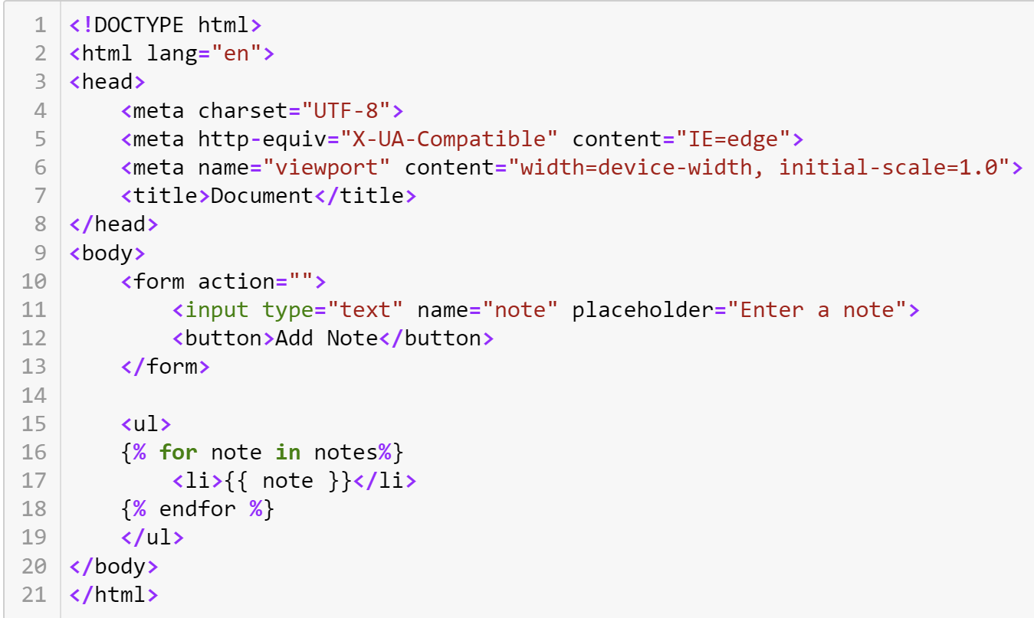
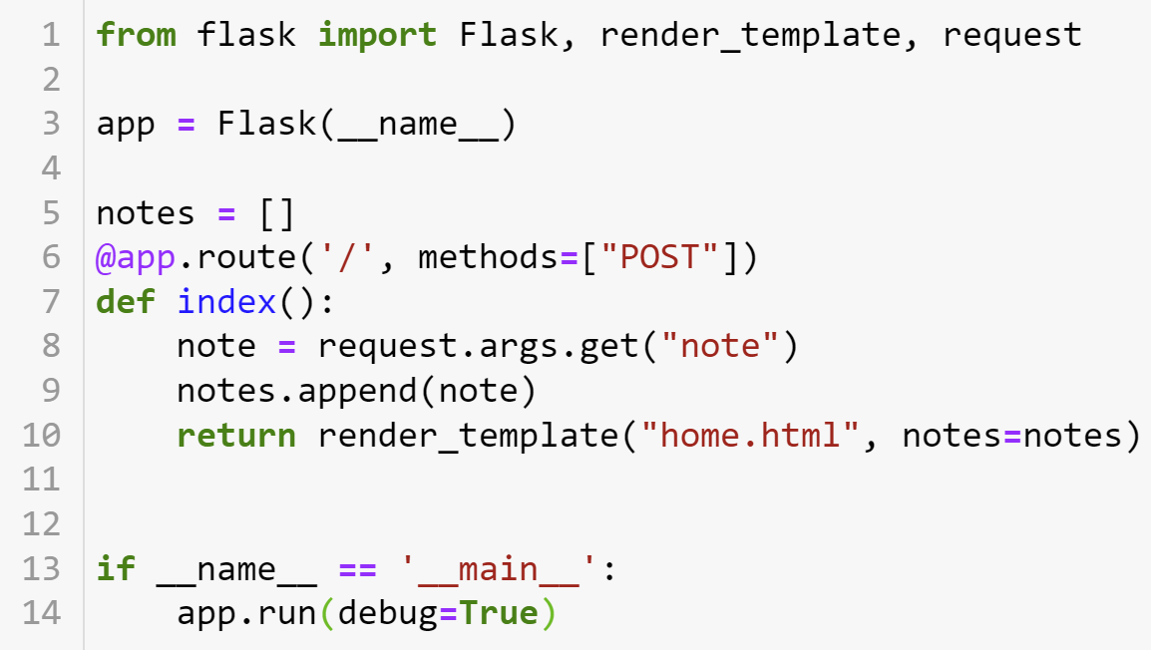
Before Debugging

Slide 7
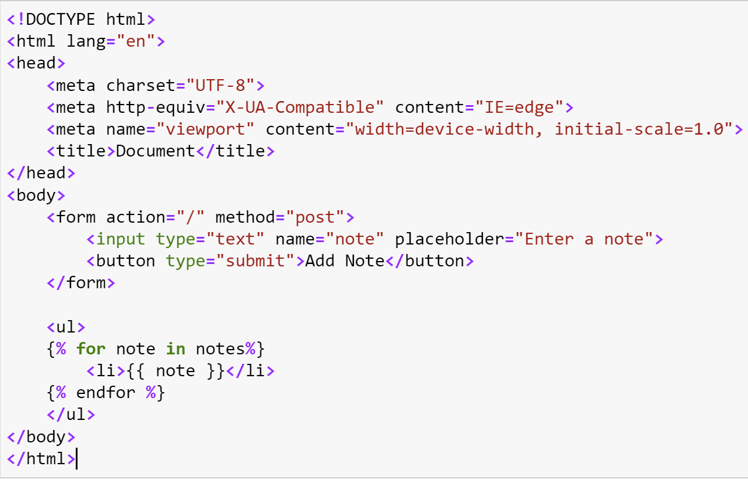
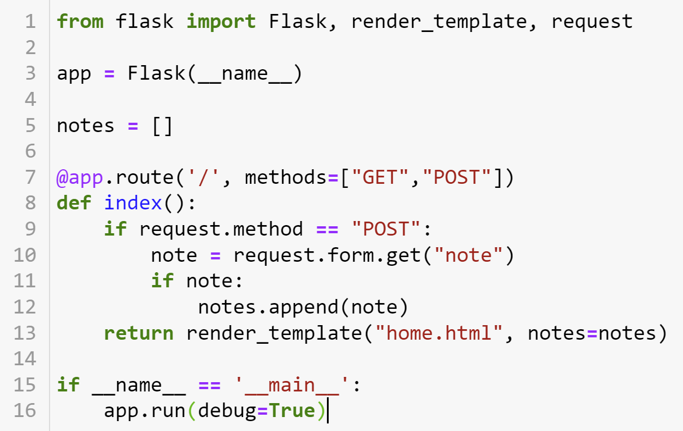
After Debugging

Slide 8
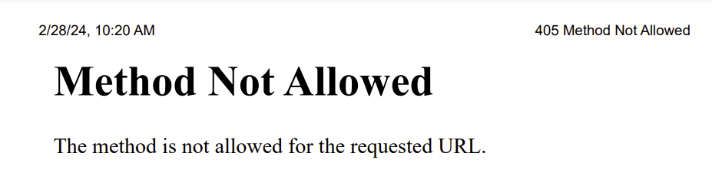
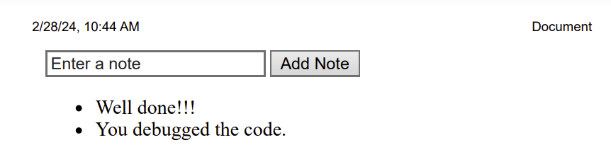
Before Debugging
After Debugging

Slide 9
Conclusion
The bug was successfully resolved by updating the Flask route to handle both GET and POST requests and adjusting the logic to retrieve the note from the form data for POST requests. This modification allows the application to function as intended, enabling users to seamlessly add notes through the text field. All entered notes are now displayed as an unordered list below the text field on the same page.
The refactoring process involved addressing issues related to the handling of HTTP requests, ensuring proper data extraction, and enhancing the overall functionality of the Note Taking Application. This collaborative effort, coupled with the utilization of online resources, significantly contributed to the successful resolution of identified bugs.

Slide 10

THANK YOU

